Slide 1
THE BANDITAB
The best TABLET in the world!!!
ITS THE ONLY TABLET YOU WILL EVER NEED !

Slide 2
PROFILE OF GROUP
Conor : Age:13, Job : Group profile
Vinayak: Age:13,Job: Power point and website
Alba: Age: 13, Job: presenting
Alex: Age: 13, Job: Presenting ,Comment: Hello! I’m Alex! I’m presenting you this amazing product called ‘Bandi Tab’. It’s one of the best products in the world! This tablet is suitable for students in primary school, secondary and college. This is also suitable for people who don’t want to carry around a tablet all around the place. ☺
Sorcha: age 13, Job: Logo and Slogan

Slide 3
The graph of tablets

Slide 4
THE WEBSITE
CLICK THE PICTURES TO VIEW THE WEBSITE

Slide 5
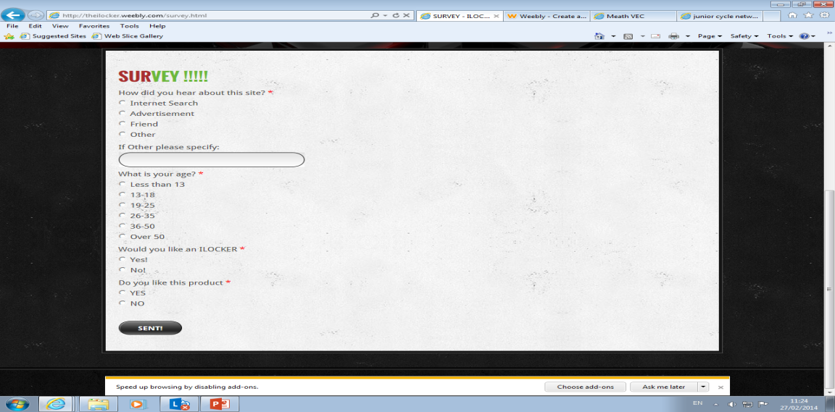
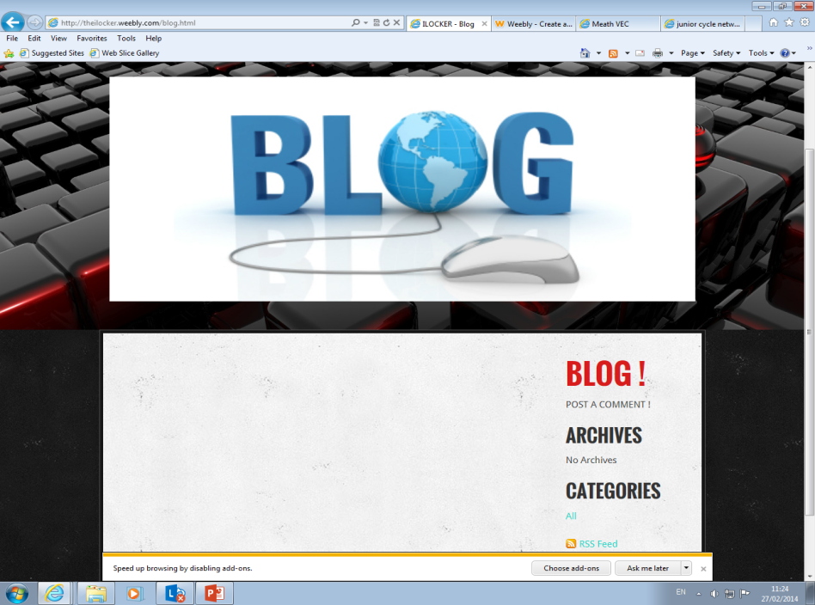
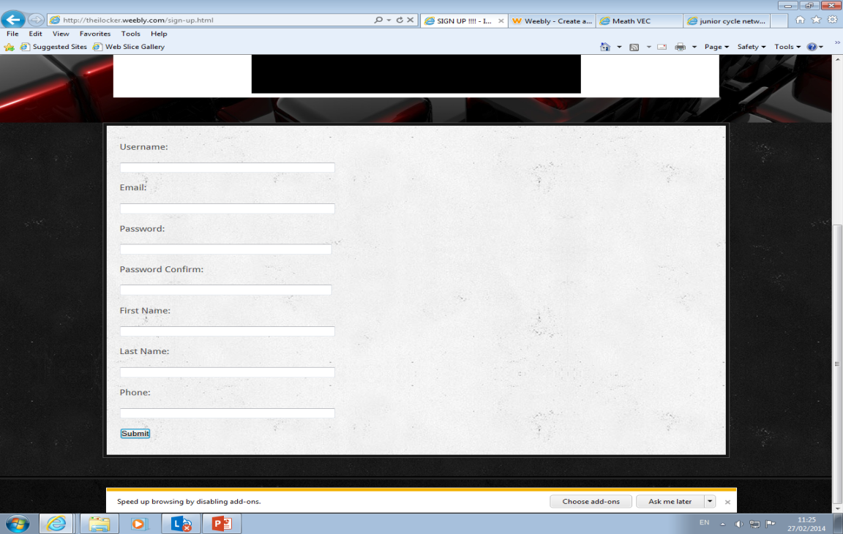
Features of the website
Click pictures to view the website page

Slide 6
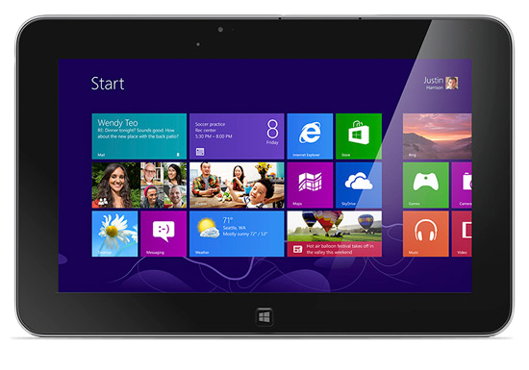
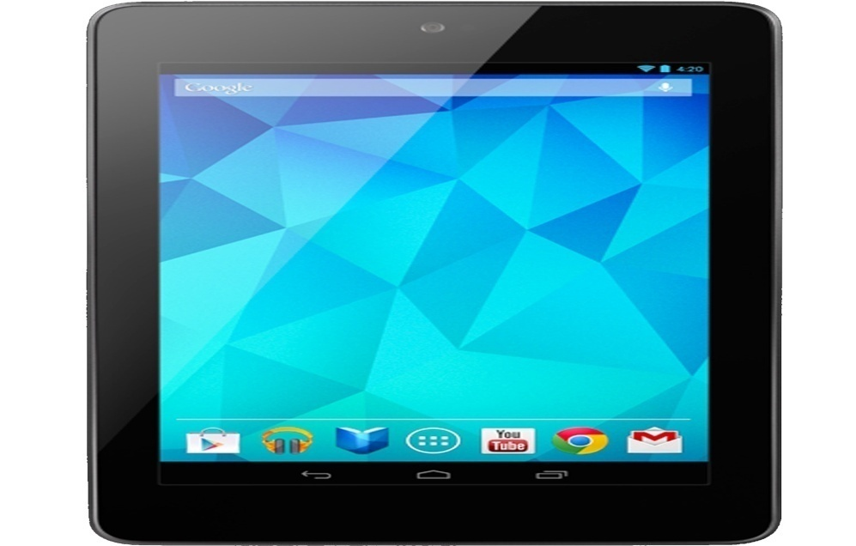
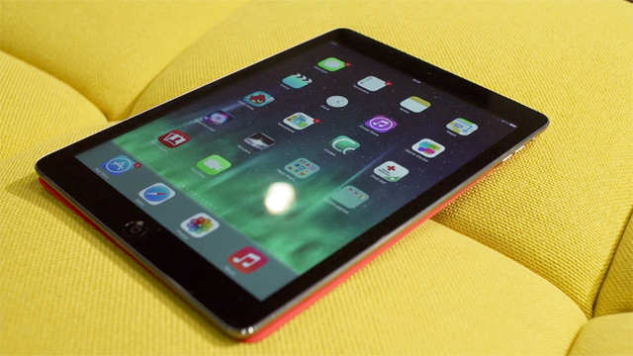
Pictures
THE BEST
Check out these pictures !!!!!!!!!!

Slide 7
CONTACT
EMAIL=13VUnnithan.RTH@lmetb.ie
EMAIL=13CTierney.RTH@lmetb.ie
EMAIL=13AWalsh.RTH@lmetb.ie
EMAIL=13SQuinn.RTH@lmetb.ie
EMAIL=13AGhiorghita.RTH@lmetb.ie

Slide 8
THE END !!!
BY VINAYAK,ALBA,SORCHA,CONOR AND ALEX

